Slide 1
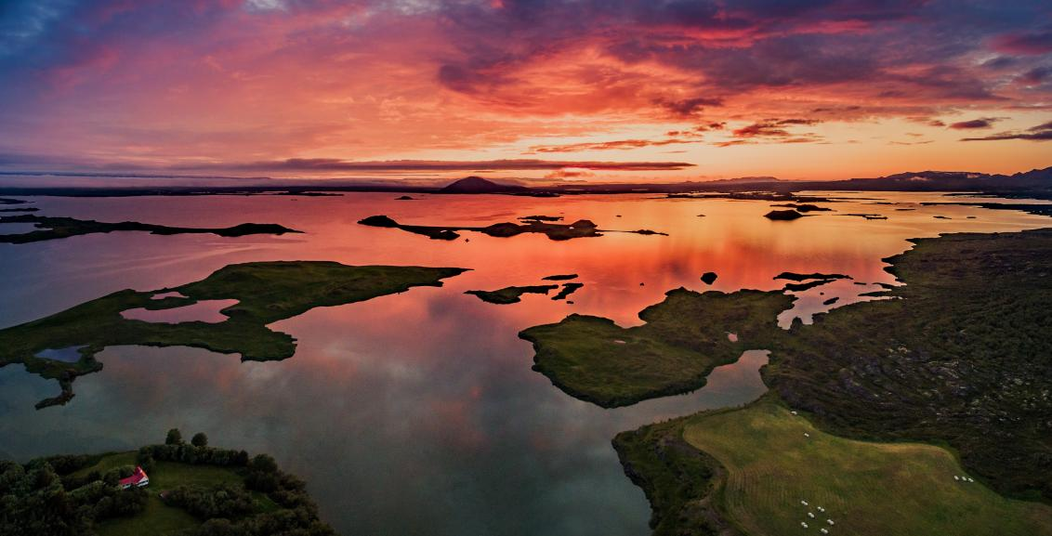
The Big Geography Quiz Summer 2021

Slide 2
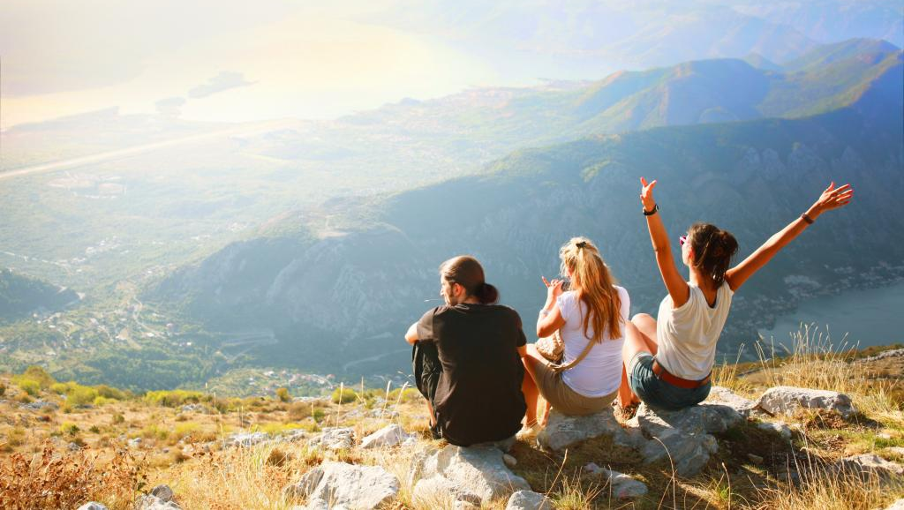
In partnership with…
CRITICAL THINKING
Round 10

Slide 3
In partnership with…
BEFORE YOU GET QUIZZING…
Who are Critical Thinkers?
Critical Thinkers is a social enterprise, with the mission of empowering the next generation to become more resilient, emotionally intelligent and, in turn, more effective critical thinkers.
They offer free resources, courses from their panel of experts and innovative awards.
We will be working with Critical Thinkers to help us provide Resilience and Wellbeing School Trips that are designed by psychologists and education specialists.

Slide 4
Question 1
Critical thinking includes:
analysing
questioning
blaming
evaluating

Slide 5
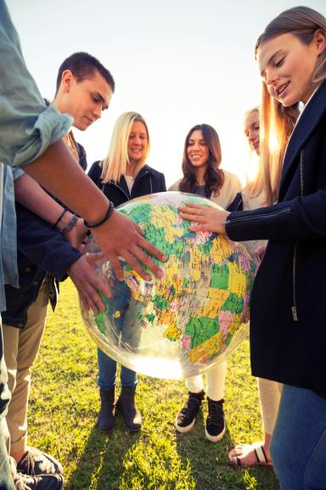
Question 2
Divide these into facts and opinions
Geography teachers are the best teachers
The Azores Islands are part of Portugal‘s territory
c. National Parks are important to protect nature
d. Tropical storms are classified as hurricanes when they reach 74mph

Slide 6
Question 3
Divide these into facts and opinions
2021 has seen volcanic eruptions lasting many weeks in Iceland and Italy
Geography students are the best students
c. China is the country with the highest population
d. There are five oceans on Earth

Slide 7
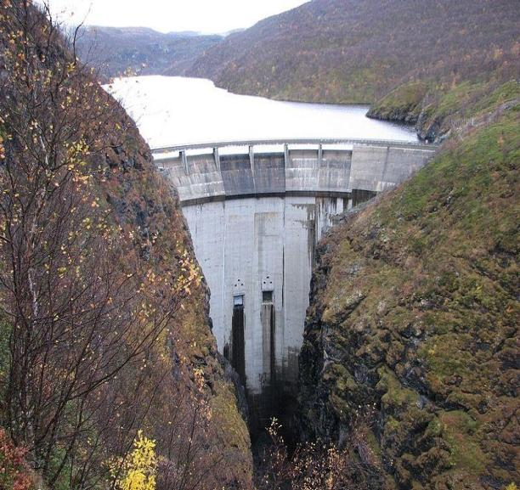
Question 4
Source
Norway has 1660 hydro power stations which generate 96% of the country‘s electricity.
Name two positive factors about using hydro power.

Slide 8
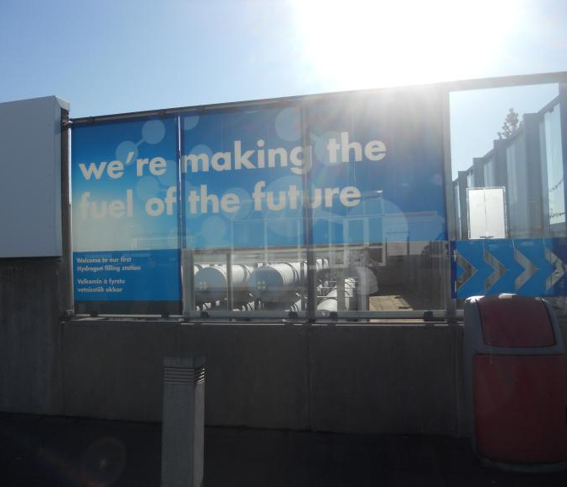
Question 5
Norway has 1660 hydro power stations which generate 96% of the country‘s electricity.
Name two potential negative factors about hydro power.

Slide 9
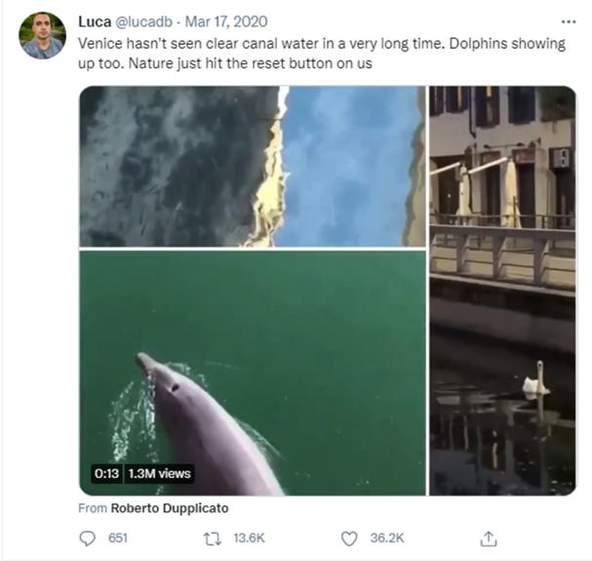
Question 6
This tweet went viral early in the covid-19 pandemic.
Newspapers made stories out of it. What questions could you ask to consider if the tweet is reliable?
Source

Slide 10
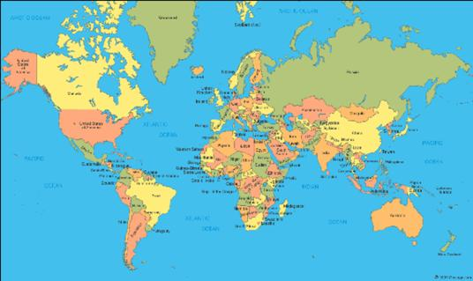
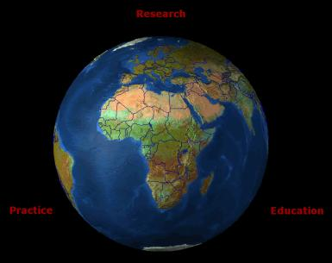
Question 7
Source
Mercator projection political map
Here are two different ways of looking at Earth.
Some people call the Mercator projection map ‘biased’ – why do you think this is?
Source
Satellite image of Earth with borders superimposed.
Source

Slide 11
Question 8
Which of these words could be used to describe this quote?
a. Exaggerated
b. Powerful
c. Biased
d. True
e. False
f. Passionate
“We don’t have time to sit on our hands as our planet burns. For young people, climate change is bigger than election or re-election. It’s life or death.”
- Alexandria Ocasio-Cortez, US Politician

Slide 12
Question 9
Can we prove this quotation is factually accurate?
“Since 1800, the amount of carbon dioxide in the atmosphere has increased from about 280 parts per million to 410 ppm in 2019.”
- David Herring and Rebecca Lindsey, US Government’s NOAA Climate Program Office

Slide 13
Question 10
“I want you to feel the fear I feel every day. I want you to act. I want you to act as you would in a crisis. I want you to act as if the house is on fire, because it is.”
- Greta Thunberg, Swedish Activist
Is this quotation biased? How do you know it is or isn‘t?

Slide 14
Answers - Round 10
A) analysing, B) questioning, C) evaluating
A)O, B)F, C)O, D)F
A)F, B)O, C)F, D)F/O
Reduced carbon emissions / greenhouse gases as so little use of fossil fuels for electricity. Norway can be self-sufficient for electricity production. It is renewable and reliable since rainfall in Norway is high and frequent.
The dams will disrupt natural water systems. Dam construction requires a lot of concrete which producing carbon dioxide emissions. Lakes created by the dams displace people and take away habitats for wildlife. Hydro power stations are expensive to build. Norway is very reliant on one type of electricity production, which some may also criticise in comparison to a more balanced energy mix of responsible sources.
Who tweeted it and what might their motive have been? What kind of opinions do they have about Venice, the environment, or the pandemic? Is what we see in the pictures actually unusual? When were the images taken? Are other people posting things that provide more evidence to support this?
Mercator projection makes countries in high latitudes (such as northern Europe) appear larger than they are and makes countries in equatorial regions (such as Africa) appear relatively small
All of them! Could argue true and/or false depending on how literally you take the words “our planet burns“ and what kind of scale it applies to. There may be data to prove that young people consider climate change a bigger issue than the election but this is not presented here.
Yes, but probably not by us as individuals, (unless we were around in 1800 or have ourselves measured CO2 from ice cores!) We need to consider scientific evidence to see that a range of sources will support this data.
Yes, biased. Dramatic and exaggerated wording, e.g. “house is on fire“. It is encouraging people to feel certain emotions “feel the fear“ rather than presenting factual information or presenting an opinion so that people can make up their own mind. It is very emotional and panic-inspiring.

