Slide 1
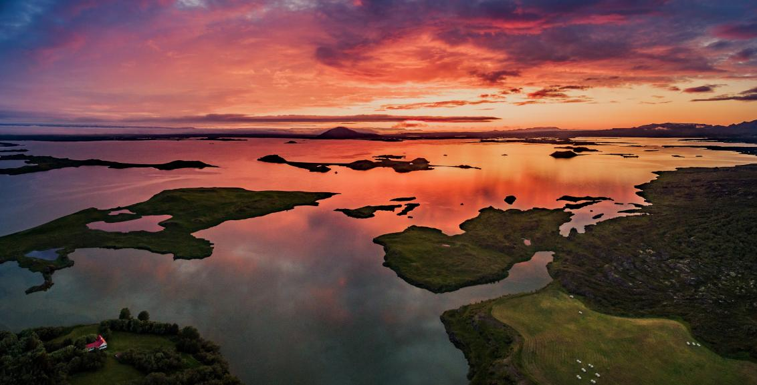
The Big Geography Quiz Summer 2021

Slide 2
GEOGRAPHY IN THE NEWS
Round 5

Slide 3
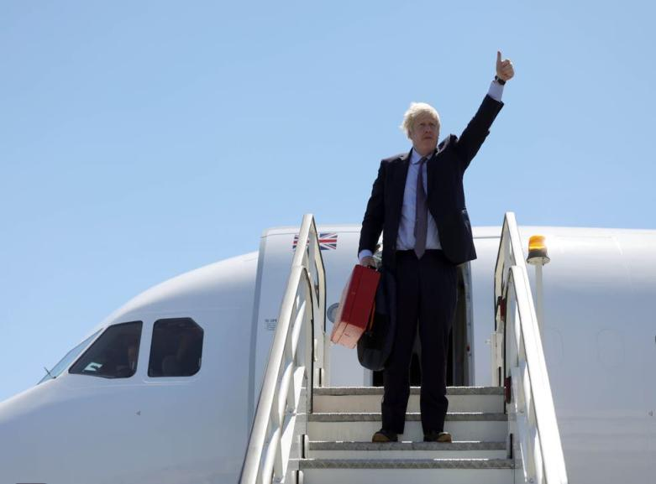
Question 1
Why was Boris Johnson under fire for flying from London to Cornwall in June?

Slide 4
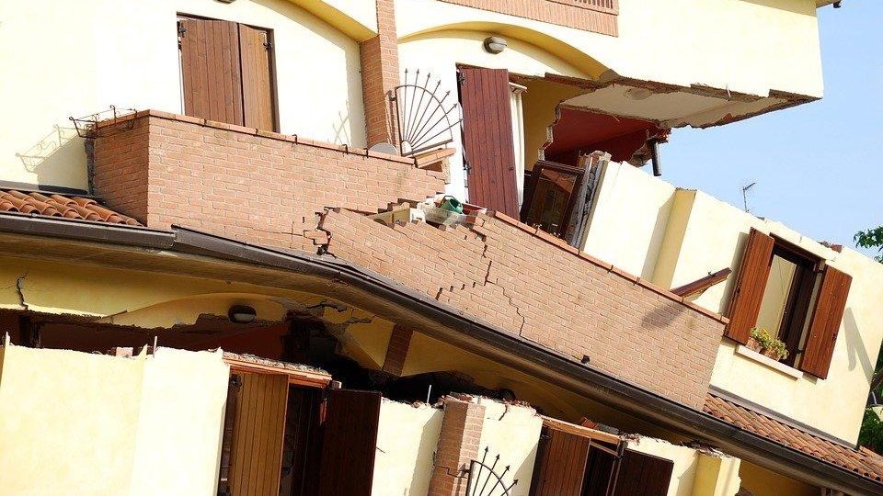
Question 2
In February 2021, a major earthquake struck Fukushima – almost ten years exactly since the deadly 2011 event.
Where is Fukushima?
What facility at Fukushima was a real worry in case it was damaged?

Slide 5
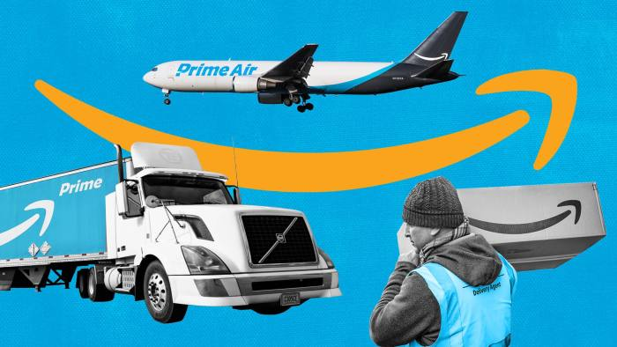
Question 3
Billionaire Jeff Bezos (owner of Amazon) is planning on flying to which unusual location in July?

Slide 6
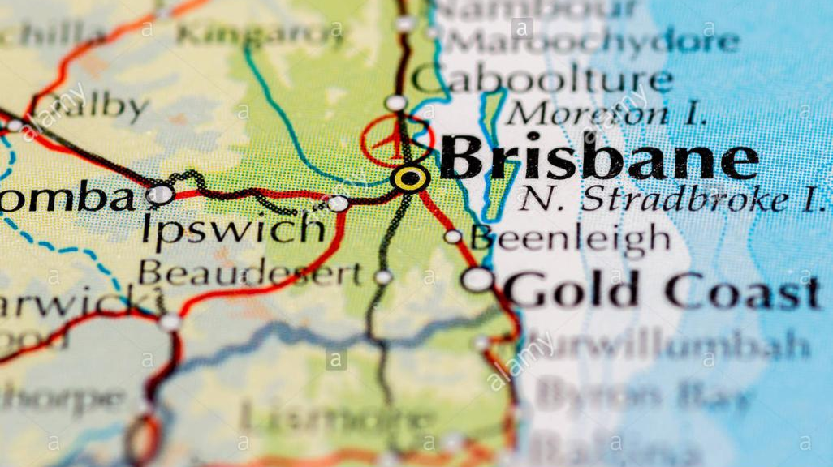
Question 4
What extreme weather hazard struck eastern Australia in March 2021?

Slide 7
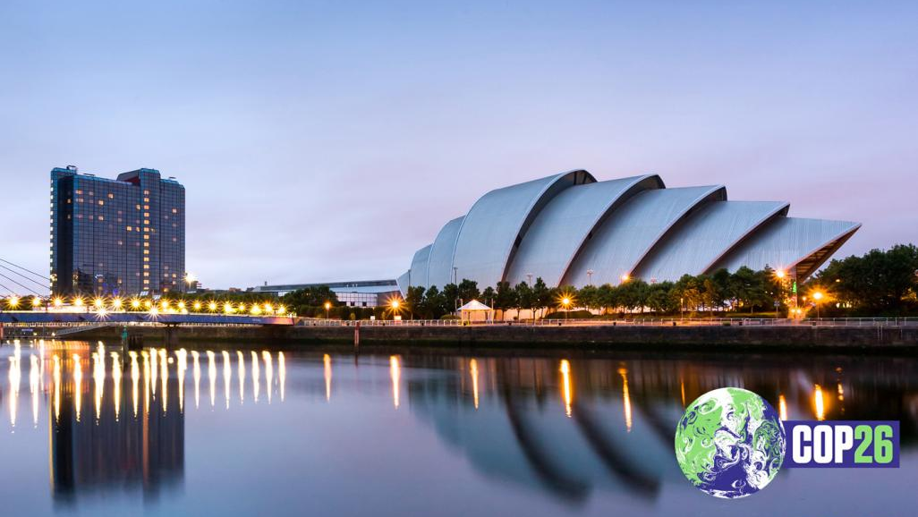
Question 5
Due to take place in Glasgow in November, what is the COP26 summit of world leaders about?

Slide 8
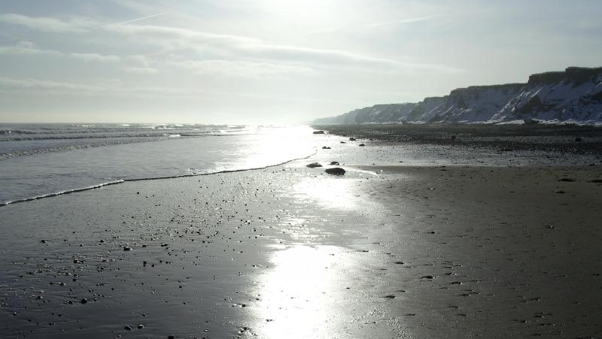
Question 6
What has got the residents at Skipsea, Holderness, so worried and that means only 16 properties remain inhabited?

Slide 9
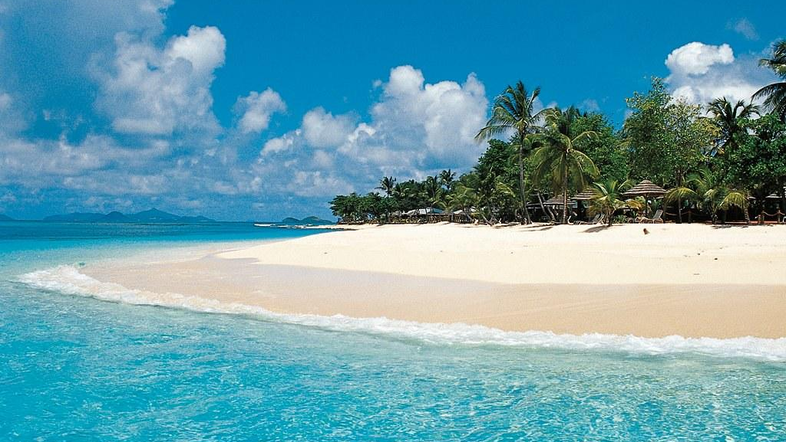
Question 7
La Soufriére in the Caribbean island of St Vincent made the news in April 2021. What is it?

Slide 10
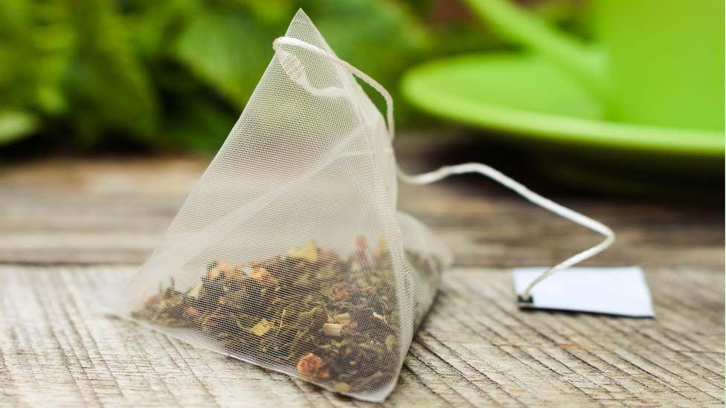
Question 8
Which supermarket has announced a ban on single-use plastic from all own-brand tea bags in UK stores by the end of 2021?
Aldi
Tesco
Morrisons
Waitrose

Slide 11
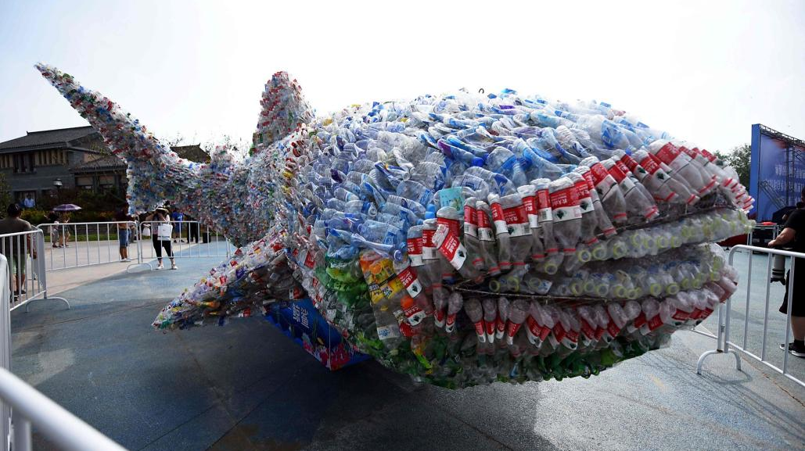
Question 9
How large is the Great Pacific Garbage Patch in 2021 approximately?
160 square kilometres
1.6 million square kilometres
160000 square kilometres

Slide 12
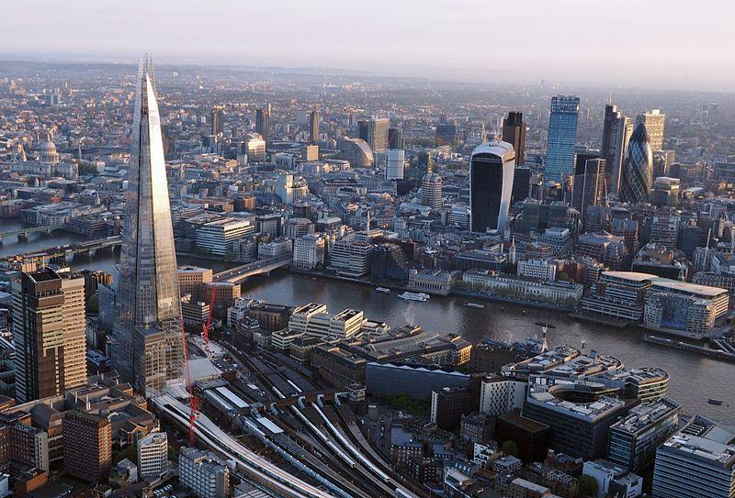
Question 10
What event is being hosted by eleven cities including Bucharest, Amsterdam and London?

Slide 13
Answers: Round 5
Flying produces greenhouse gases, and the conference was focusing on climate change so it seemed ironic.
A) Japan B) nuclear power plant
The moon
Floods, flash flooding
Climate change conference
Coastal erosion, the risk of homes falling into the sea
Volcano
A) Aldi
B) 1.6 million square kilometres
Euro 2020 football competition

