Slide 1
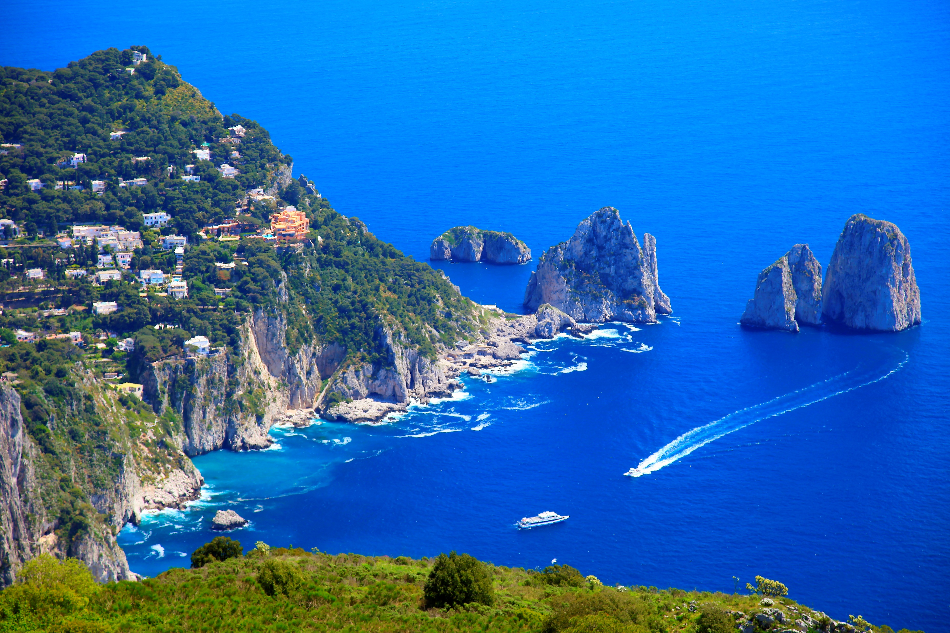
Coastal Case Study - Italy
1: Describe the location of Italy. | 2: Identify one economic activity that could take place in the image from the case study. | 3: Suggest one threat to this location from the image. | 4: Explain how humans have influenced the coastline here. | 5: Suggest one potential negative consequence of tourism.
14: Hypothesise how climate change might influence this case study landscape. |  |  |  | 6: Give one piece of evidence from the image to support your answer to Q5.
13: Predict how this coastline might change in future. |  |  |  | 7: Name whether this is a destructive or constructive coastline and give reason why.
12: Suggest what ‘sustainable coastal management’ might mean. | 11: Justify whether hard engineering would be appropriate here. | 10: Outline one way that this landscape provides a recreational resource. | 9: State one social or economic risk to humans in this coastal area. | 8: Describe what is meant by coastal management.
Capri coastline, Italy

Slide 2
Coastal Case Study - Italy
1: Describe the location of Italy. Italy is a Mediterranean country in southern Europe. Northern Italy joins mainland Europe next to France, Switzerland, Austria and Slovenia. | 2: Identify one economic activity that could take place in the image from the case study. e.g. Boating is visible, which could provide economic activity such as tourist boat trips, fishing, or private moorings. | 3: Suggest one threat to this location from the image. e.g. boats can pollute coastal waters through waste diesel, oil and unsanitary waste; threat of cliff erosion and collapse, etc. | 4: Explain how humans have influenced the coastline here. There is a small settlement visible, with buildings along the headland and roads to get there which will have all caused changes to the natural landscape. | 5: Suggest one potential negative consequence of tourism. e.g. increased tourism can lead to congestion of roads and beaches or changing land use through clearance of vegetation to build on; increased water pollution, etc.
14: Hypothesise how climate change might influence this case study landscape. Climate change accelerating sea level rise can threaten this area because higher seas raises the level of high tide and therefore increases the area exposed to speed up erosion. |  |  |  | 6: Give one piece of evidence from the image to support your answer to Q5. e.g. vegetation has been cleared along the headland to create space for buildings that might be hotels and restaurants, causing loss of habitats.
13: Predict how this coastline might change in future. This is an erosional coastline which if left unprotected in future the stacks will break down to form stumps, and then the stumps will disappear below sea level. The cliffs will continue to slump & houses will be lost to the sea. |  |  |  | 7: Name whether this is a destructive or constructive coastline and give reason why. This is a destructive coastline, because the landforms such as stacks are created by erosion not deposition meaning there are stronger destructive waves.
12: Suggest why we should be concerned by microplastics in the sea here. Microplastics in the Mediterranean have been found in sea salt, mussels, crustaceans, etc. which are all commonly used for both local food and exports and can have human health consequences. | 11: Justify whether hard engineering would be appropriate here. It is a very small settlement on a highly eroded coast, which would mean that the financial costs of hard engineering would be greater than the benefits. | 10: Outline one way that this landscape could provide a recreational resource. Residents or tourists could enjoy a walk along the paths along the headland, or take a boat tour to enjoy the scenery, or swim, etc. | 9: State one social or economic risk to humans in this coastal area. e.g. Social risks include loss of homes and possessions if cliffs collapse; economic risks include financial losses from insurance costs in risky areas or damages caused by erosion | 8: Describe what is meant by coastal management. Coastal management is the process of decision making by authorities and stakeholders (e.g. environment agencies, government, residents) to determine how to best use and manage a coastline.
What about plastic waste in the oceans? Follow the link to see what the Kids Against Plastic Team have to share.

