Slide 1
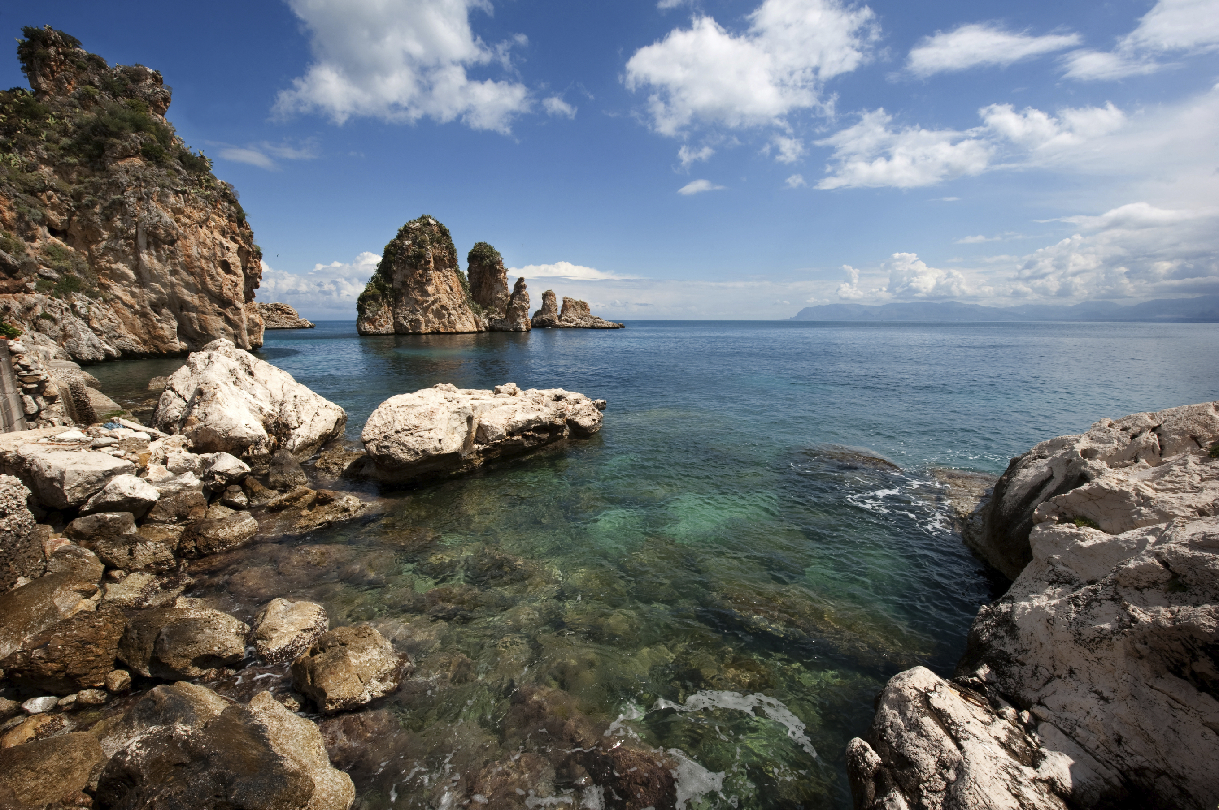
Coastal Landscapes & Features
1: Define ‘coastal landscape’. | 2: Identify what a ‘wave cut platform’ is. | 3: State one type of coastal feature from the photo. | 4: Explain how a stack is formed. | 5: Suggest one reason why tourism is high in coastal areas.
14: Describe the landscape shown in the photograph. |  |  |  | 6: Identify two challenges of living in a coastal landscape.
13: Theorise how humans can threaten coastal landscapes. |  |  |  | 7: Define what is meant by ‘abrasion’.
12: Suggest what ‘sustainable coastal management’ might mean. | 11: Explain how sea level change could threaten the landscape in the photo. | 10: Outline one way that coastal landscapes provide economic opportunities. | 9: State one social use of coastal landscapes in the UK. | 8: Describe one way that climate change threatens coastal landscapes.
Off the north coast of Sicily

Slide 2
Coastal Landscapes & Features
1: Define ‘coastal landscape’. e.g. The coastal landscape includes all the landscapes, features and processes along the perimeter where land and sea meet. | 2: Identify what a ‘wave cut platform’ is. A wave cut platform is a flat rocky ledge that is formed at the base of a cliff by erosion processes such as abrasion, that is most visible at low tide. | 3: State one type of coastal feature from the photo. e.g. stack, stump, headland remnants of a wave cut platform, etc. | 4: Explain how a stack is formed. A stack is an isolated rock formed from a headland that is eroded over time by hydraulic action to form a notch, which enlarges to a cave, then an arch, and then the arch collapses to leave a stack. | 5: Suggest one reason why tourism is high in coastal areas. e.g. Coastal areas provide many recreational opportunities such as leisure facilities (e.g. for holidays by the sea for swimming) and therefore attraction amenities such as restaurants, etc.
14: Describe the landscape shown in the photograph. In the foreground you can see scattered boulders perhaps from a wave cut platform that is eroding. In the backgrounds there is a headland with visible notches, and an isolated stack and stumps exposed. |  |  |  | 6: Identify two challenges of living in a coastal landscape. e.g. threat of sea flooding, threat of cliff collapse, risk of damage to property, difficulty with getting household insurance in risk zones, pressures on facilities from tourism, congestion, etc.
13: Theorise how humans can threaten coastal landscapes. One way humans are a threat includes pollution of coastal waters, particularly from increased boat traffic for tours and sightseeing that releases diesel and oil into the sea. |  |  |  | 7: Define what is meant by ‘abrasion’. Abrasion is a form of erosion whereby floating small particles in sea water act like sandpaper to gradually smooth beach sediment or cliffs over time.
12: Suggest what ‘sustainable coastal management’ might mean. Sustainable coastal management seeks to balance the needs of the present without risking the future, and balancing social, economic and environmental needs. | 11: Explain how sea level change could threaten the landscape in the photo. e.g. As sea levels rise, tides will become higher, which will increase the rate of erosion higher up cliffs and headlands therefore accelerating erosion above. | 10: Outline one way that coastal landscapes provide economic opportunities. e.g. One economic opportunity is through tourism, particularly boat tours or hiring kayaks which provides revenue for businesses. | 9: State one social use of coastal landscapes in the UK. e.g. for recreation and leisure such as dog walking, picnics, swimming, barbecues, amusement parks, golf courses, housing, etc. | 8: Describe one way that climate change threatens coastal landscapes. e.g. Increase ocean temperatures can cause damage to coastal habitats, such as destruction of coral reefs, mangroves, salt marshes, etc.
Click here for a fantastic coastal morphology video revision resource courtesy of Time for Geography, supported by Discover the World Education.

