Slide 1
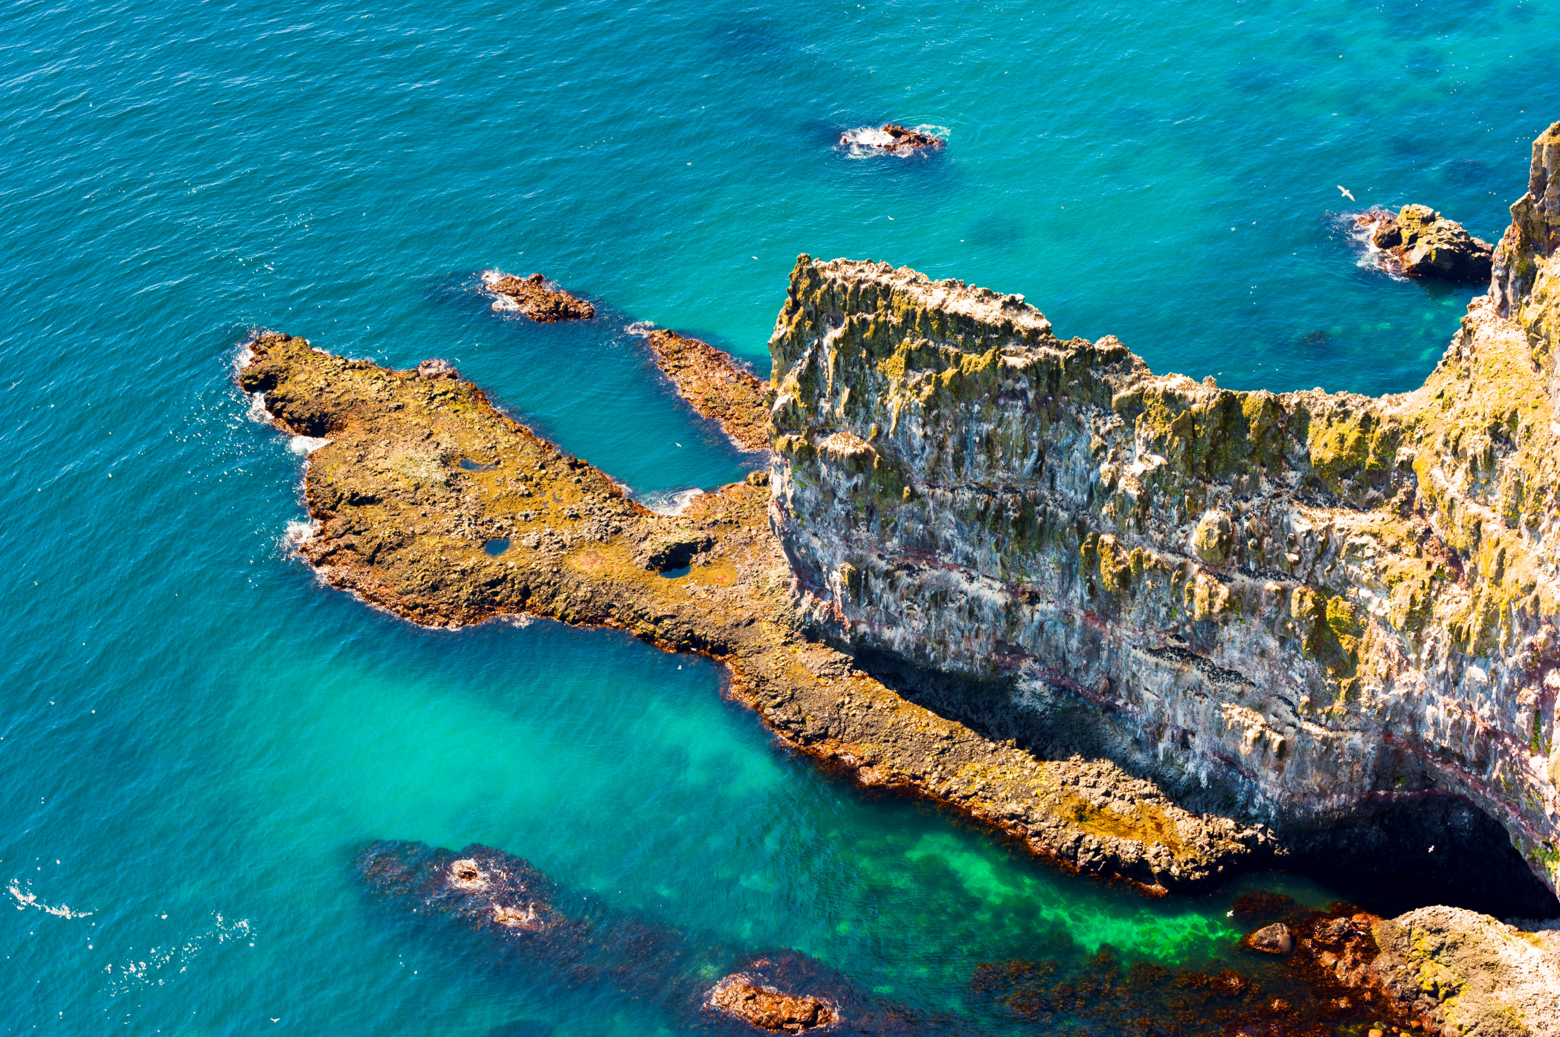
Coastal Processes
1: Define ‘coastal erosion’. | 2: Identify one form of coastal erosion. | 3: State one type of coastal deposition process. | 4: Explain how a headland is formed. | 5: Suggest what is meant by the term ‘destructive’ waves’.
14: Describe what erosional landforms are in the image. |  |  |  | 6: Identify two forms of coastal transportation.
13: Theorise how geology can influence erosion speeds. |  |  |  | 7: Define what is meant by ‘hydraulic action’.
12: Suggest what is meant by ‘soft engineering’. | 11: Explain how a coastal spit is formed. | 10: Outline how beach replenishment works. | 9: State one method of hard engineering used at the coast. | 8: Describe how longshore drift influences landforms.
Látrabjarg, West Fjords, Iceland

Slide 2
Coastal Processes
1: Define ‘coastal erosion’. The breaking down or wearing away of sediment materials, landforms and features at the coast. | 2: Identify one form of coastal erosion. e.g. hydraulic action, attrition, abrasion, corrosion | 3: Describe what causes coastal deposition. When wave swash is stronger than backwash, then sediment is deposited on the beach as the wave carries material up and then deposits as it loses energy during its return. | 4: Explain how a headland is formed. A headland is a section of harder rock that is more resistant to erosion that is left exposed jutting out to sea as nearby softer rocks erode more rapidly. | 5: Suggest what is meant by the term ‘destructive’ waves’. Destructive waves have a stronger backwash than swash, meaning there is more energy to remove material from the beach during the wave return rather than deposition.
14: State what erosional landforms are in the image. e.g. wave cut platform, headland, cave, fault, notch, stump. |  |  |  | 6: Identify two forms of coastal transportation. e.g. longshore drift through traction, saltation, suspension and solution
13: Theorise how geology can influence erosion speeds. Harder rocks such as chalk erode more slowly than soft rocks such as clay, as they are more resistant to erosion and therefore take longer to be affected. This leads to alternating erosion forming headlands & bays, etc. |  |  |  | 7: Define what is meant by ‘hydraulic action’. When water from the sea is forced into cracks and faults in rocks it compresses the air, forcing the rock to split apart and break. Over time this breaks rocks apart causing notches, etc.
12: Suggest what is meant by ‘soft engineering’. Soft engineering aims to manage the coast through more ‘environmentally friendly’ methods that work with nature, such as beach nourishment, dune stabilisation, managed retreat. | 11: Explain how a coastal spit is formed. Material from beaches is transported by longshore drift along the coast following the prevailing wind, and is deposited coming away from headlands. Spits can change direction due to currents. | 10: Outline how beach replenishment works. Material such as sand and shingle is dredged or removed from one area, and then transported to a declining beach and deposited here artificially in order to build up the beach to protect the coast. | 9: State one method of hard engineering used at the coast. e.g. sea walls, rock armour, groynes, revetments, gabions, etc. | 8: Describe how longshore drift influences landforms. It moves material along the beach in the direction of the prevailing wind as sediment is carried by the waves. This changes beach shape, causing some beaches to decline and others to build up.
Have you seen our free ‘Whales of Iceland’ resource? It considers sustainable decision making and tourism.

