Slide 1
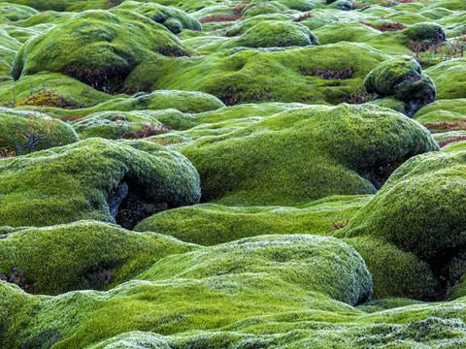
Using literature in the geography classroom
Iceland

Slide 2
Iceland in literature Magnus Iceland Mysteries series by Michael Ridpath
Example activities:
Read the extracts to students whilst they sit in the dark, or close their eyes, so there is no stimulus other than your voice speaking the text
Read extracts of the stories to students whilst they take structured notes, such as the hexagon grid
Divide the class in half, one half take notes on physical features and one half take notes on human features, then swap and share and discuss
Students remain in silence after you finish reading. They then write a piece of extended writing that describes how they think the landscape was formed, or what it would look like in the past / future

Slide 3
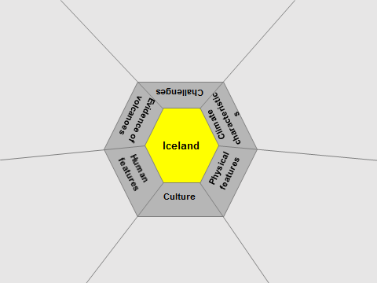
Example hexagon structure for notes

Slide 4
Challenges
Evidence of volcanoes
Iceland
Climate characteristics
Human features
Physical features
Culture
Notes:
e.g. plan your extended writing first using a template

Slide 5
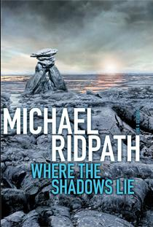
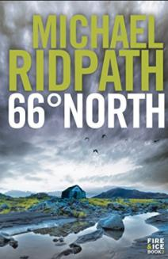
Iceland in literature Examples from the Magnus Iceland Mysteries series by Michael Ridpath

Slide 6
“This was his favourite spot. Right in the middle of the twisted waves of congealed stone that was the Berserkjahraun, or Berserkers’ Lava Field. It was a beautiful, eerie, magical place of little towers, folds and wrinkles of stone, speckled with lime green moss, darker green heather, and the deep red leaves of bog bilberries. The lava field was named after the two warriors who had been brought over to Iceland as servants from Sweden a thousand years before by Vermundur the Lean”
(Michael Ridpath’s ‘66° North)

Slide 7
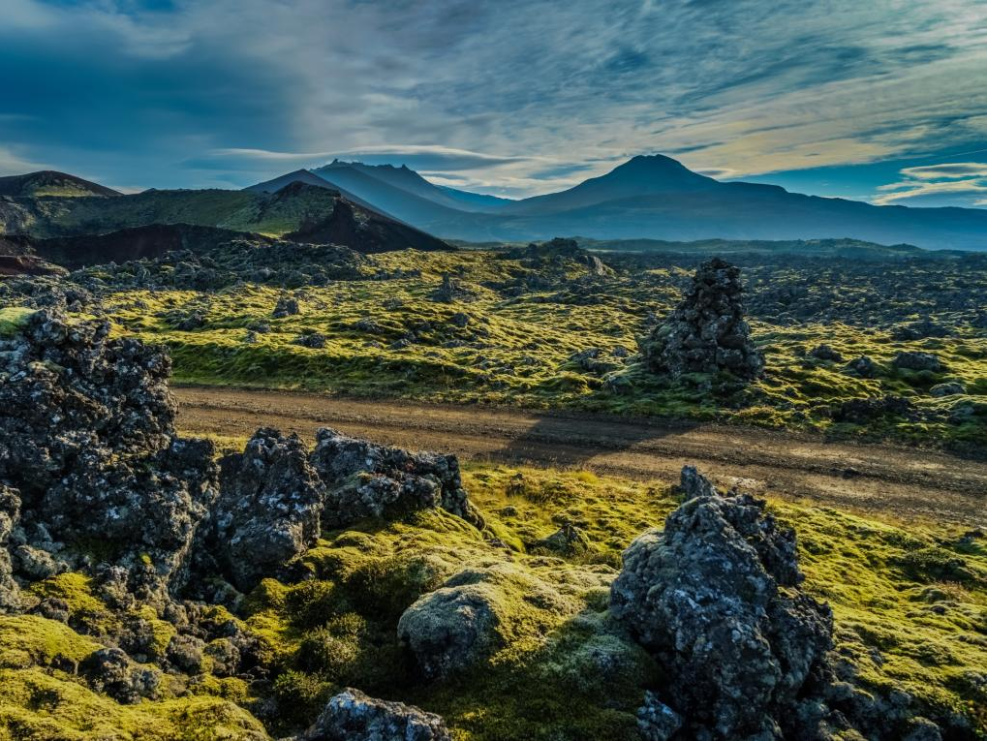

Slide 8
“The cairn was in a depression, out of sight of grown-ups, which made it such a good playing place. Hallgrímur climbed the ancient footpath between the two farms, which had been hewn out of the lava a millennium before by the berserkers themselves, and looked west towards Bjarnarhöfn. It was a prosperous farm, nestling beneath a waterfall which tumbled down the side of Bjarnarhöfn Fell. It was surrounded by a large home field, bright green against the brown of the surrounding heath. A tiny wooden church, little more than a black hut, lay between the farm and the grey flatness of Breidarfjördur, the broad fjord dotted with low islands. Just up from the shoreline were wooden racks on which lines of salted fish hung out to dry.” (Michael Ridpath’s ‘66° North)

Slide 9
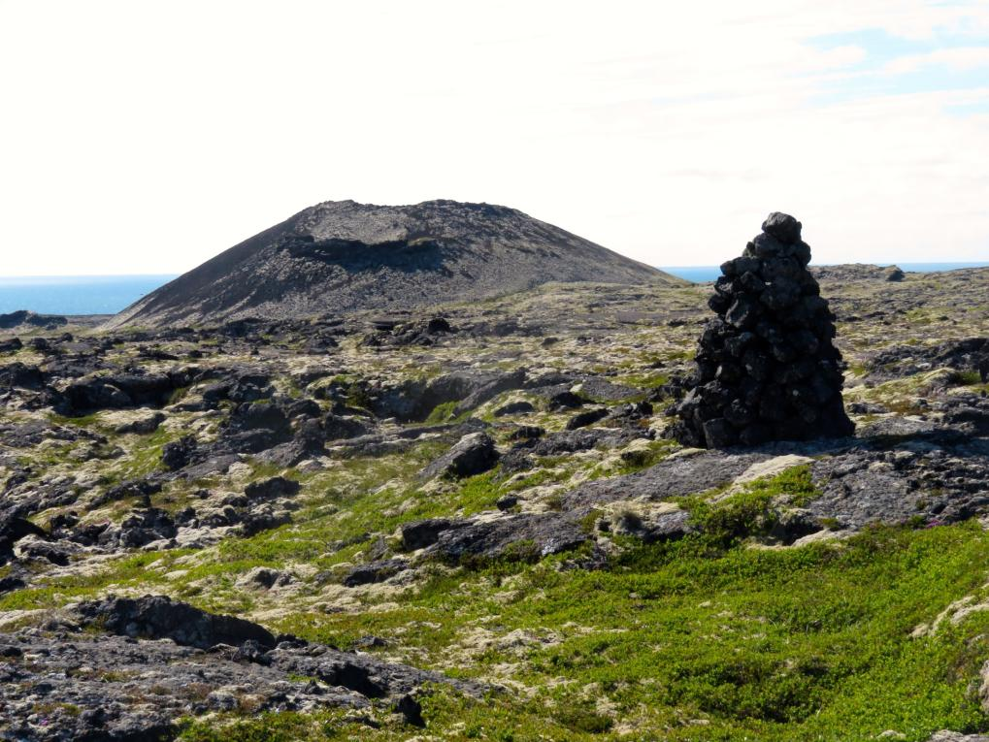

Slide 10
“They crept southwards through the lava field. It had spewed out of the big mountains to the south several thousand years ago, ending up in the fjord just between the two farms at a place called Hraunsvik, or ‘Lava Bay’. For several kilometres it flowed in a tumult of stone and moss, twenty or thirty metres above the surrounding plain. It was possible to crawl along the wrinkles of the lava, to slither through cracks, to lurk behind the extraordinary shapes that reared upwards. There was one spot where the lava seemed to form the silhouettes of two horses standing together, when viewed from a certain angle.” (Michael Ridpath’s ‘66° North)

Slide 11
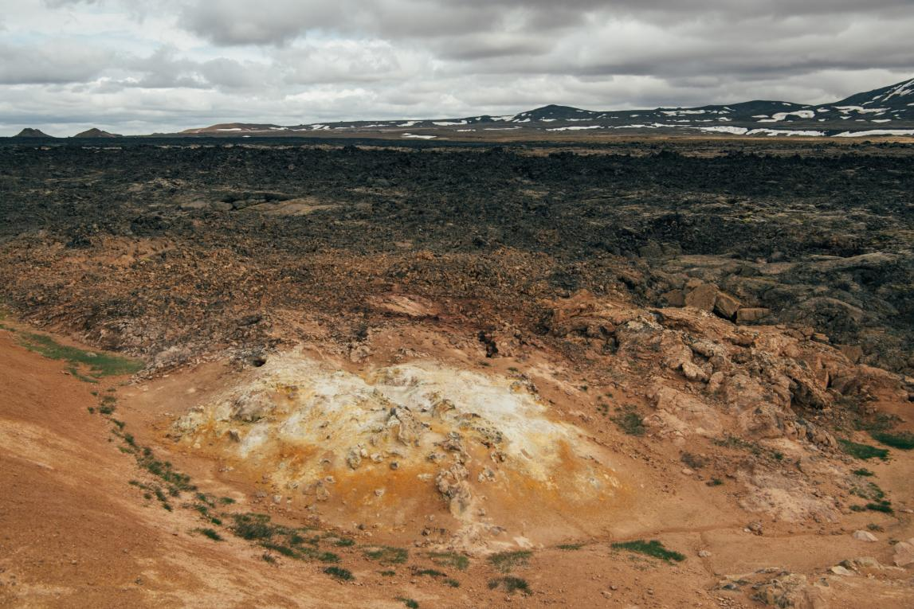

Slide 12
Other suggestions
Remain in silence, no discussion, students to create an annotated field sketch of the landscape described in the text. Share with a friend & discuss.
Students write down as many key geographic words as they can remember from the text and define them. Quiz each other.
Reveal a photograph of the suggested landscape. Discuss with students – is this what you visualised, what is different, do you agree with what is shown.
Debate the information from the text e.g. ‘Iceland is distinctive because…..’
Follow up by researching places named in the text to identify if they are accurately portrayed
Use Google Earth / GIS to explore the locations described in the text and compare to the text information
Extended writing challenge

Slide 13
Extended writing activity example
After you have read some text descriptions of Iceland together, analysed the photographs, and explored the landscape, set students an extended writing challenge.
e.g. What makes Iceland such a distinctive place?
You can provide support through different forms such as VCOP or learning grids or structure strips as required.

Slide 14
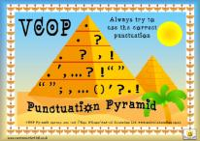
Extended writing support: learning grid
 | volcanic rural urban distinctive physical features atmospheric human features climate polar aurora borealis jökulhlaup sustainability energy environment lava
 | however likewise whereas even though on the other hand unlike contrasting to in addition to despite because so as to nevertheless although similarly
 | The distinctive features of Iceland include ………………. There are physical characteristics such as ………………….. In order to be sustainable, Iceland ……………………… The risks of volcanic eruption are……………………however…….. Some ways that local people use the land include….however tourists also use the land to…..
V
ocabulary
C
onnectives
O
peners
P
unctuation

Slide 15
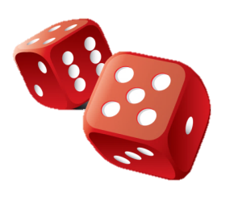
Example Learning Grid (they can be 4x4 or 6x6)
Students roll the dice to give a coordinate. Repeat three times to highlight three boxes. Use the box commands as writing prompts.
 | 1 | 2 | 3 | 4
1 | Link to physical features | Refer to land use by local people | Impacts of eruptions | Suggest what risks there may be to Iceland from volcanoes
2 | Include key geographic words | Link to tourism & why visit Iceland | Describe human features of Iceland | Describe rural areas
3 | Explain what happens when volcanoes and ice mix | Suggest what Iceland’s economy is based on | Explain what the mid-Atlantic Ridge is | Suggest how volcanoes bring benefit to Iceland
4 | Rural areas are largely quite traditional | Consider how and why volcanoes erupt | Describe urban areas | Refer to volcanic theory

Slide 16
Structure Strip: What makes Iceland such a distinctive place?
Introduction Define ‘distinctive’. Locate Iceland. Introduce the concept of distinctive landscapes & physical / human features. | What makes a place distinctive or unique? How is Iceland different to the UK?
Describe the physical landscape Consider: climate, relief of the land, causes and impacts of volcanoes, adaptation, etc. Keywords: volcano/es, relief, rift, tectonics, divergent plate, polar, maritime | What are the key physical features? Why is Iceland part of two continents? How does volcanic activity in Iceland make it distinctive to other places?
Describe how people use the land Consider: tourism, local residents, farmers, geothermal energy, etc. Keywords: tourism, adventure tourism, agriculture, fertile, renewable, energy | Why do people live in Iceland? Why do tourists visit Iceland? Why is it so unusual for Iceland to be able to grow bananas?
Conclusion Make a summary statement. Justify your statement with evidence from your earlier points. | Overall what makes Iceland distinctive, in your opinion? What is the most distinctive feature?

Slide 17
Text analysis activity example
Students are given copies of a text extract and asked to read, analyse, and highlight for certain criteria, e.g.
Geographical key term
Adjectives
Metaphor / simile
Following this, ask students to compare the information given in texts to what they already know.
How accurate is the literature?
Can we rely on geographical fiction for geographical fact?
How could you improve the text to be more accurate?

Slide 18
Text analysis activity example
“‘It looks powerful from here, but this is actually a small eruption’ said Nico. ‘It’s what’s called an effusive eruption. They’re the pretty ones. Basalt lava gets thrown up into the air and then flows down the side of the mountain’. ‘What’s the other type?’ Erika asked. ‘Explosive eruption. That’s when the magma explodes into ash and is flung way up into the atmosphere. They are nasty: you don’t want to be anywhere near one of those.’…’They say there’s a chance that Katla will blow, that’s a big volcano under the Mýrdals Glacier back there. If it does there could be a real mess – massive floods. The eruption melts the ice in the glacier, and the meltwater surges down the mountain in a series of powerful flash floods. Jökulhlaup, I think the Icelanders call it – glacier leap. You really don’t want to be in the way of one of those.’ They stared at the convulsions of the volcano in awe.”
(Michael Ridpath, Meltwater)

Slide 19
