Slide 1
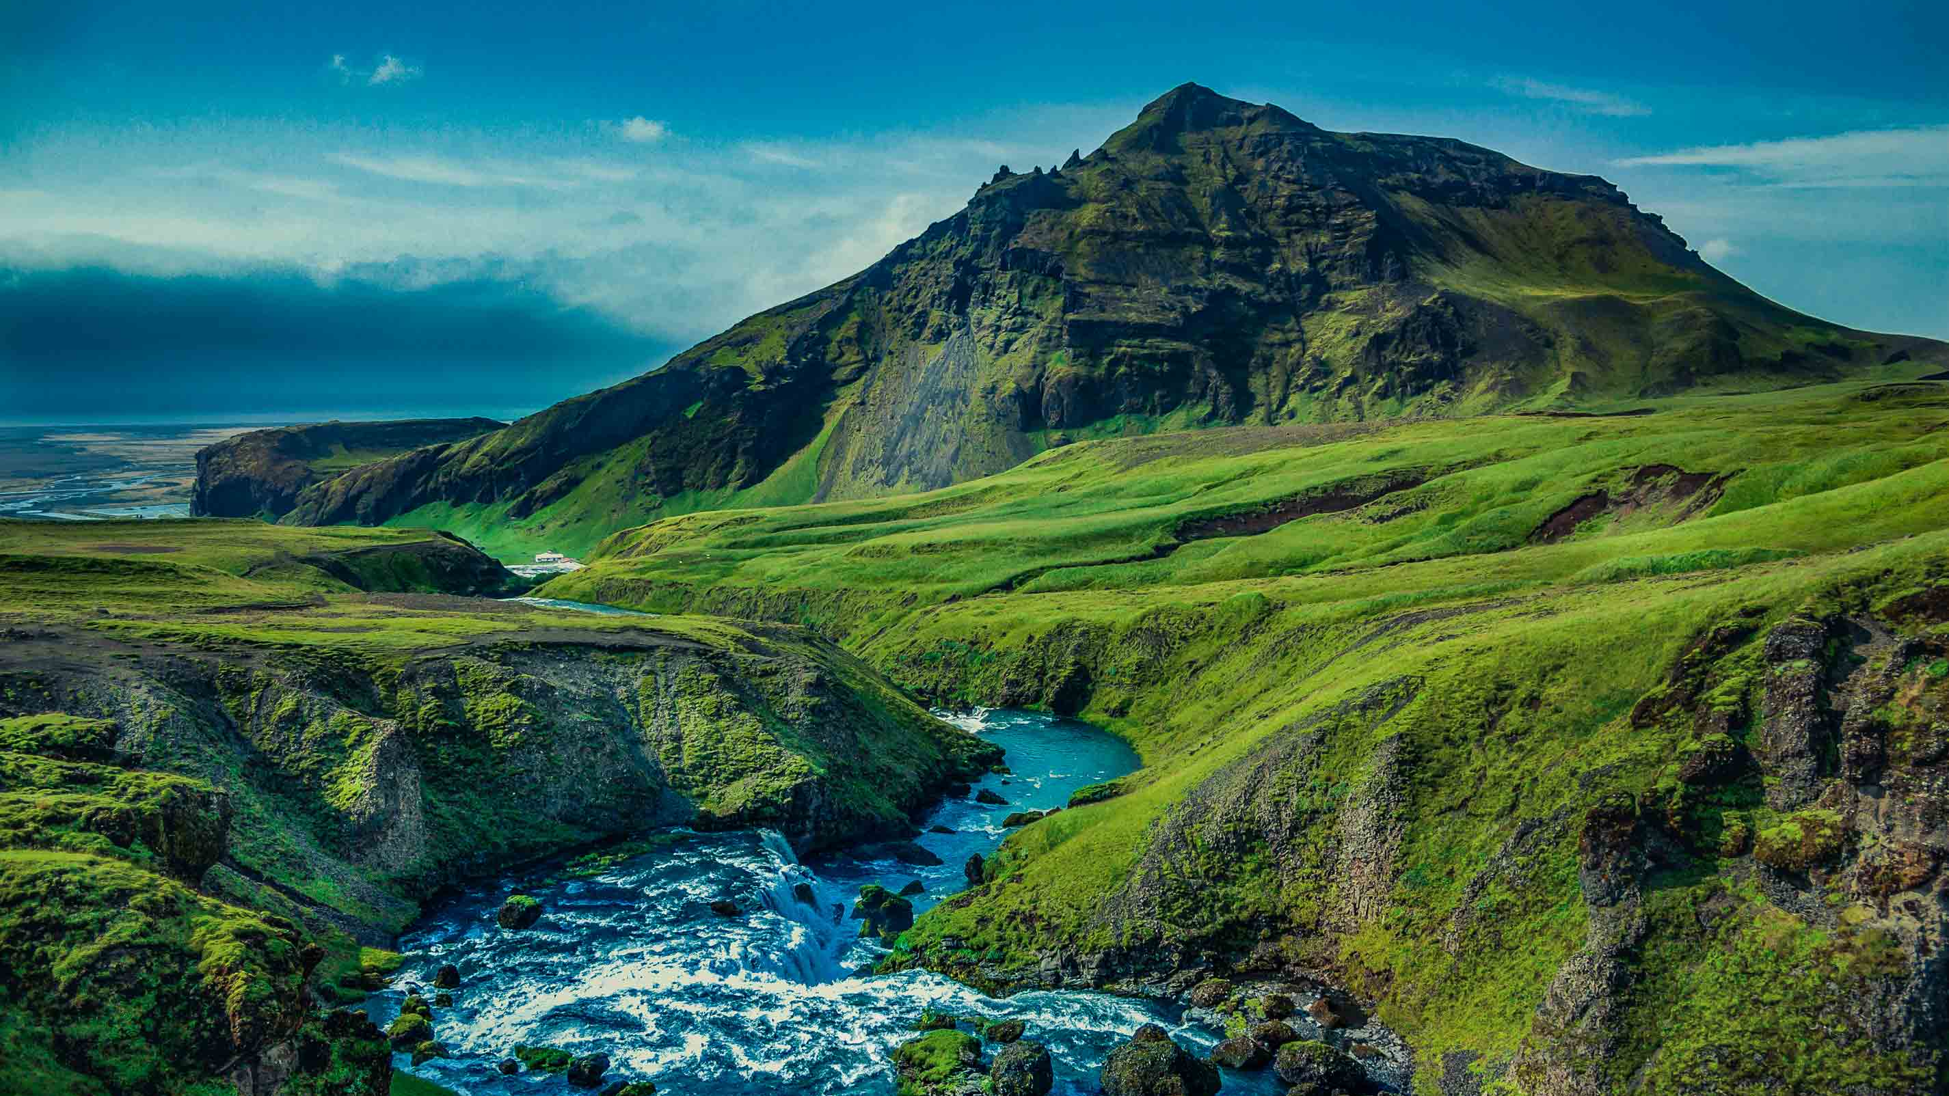
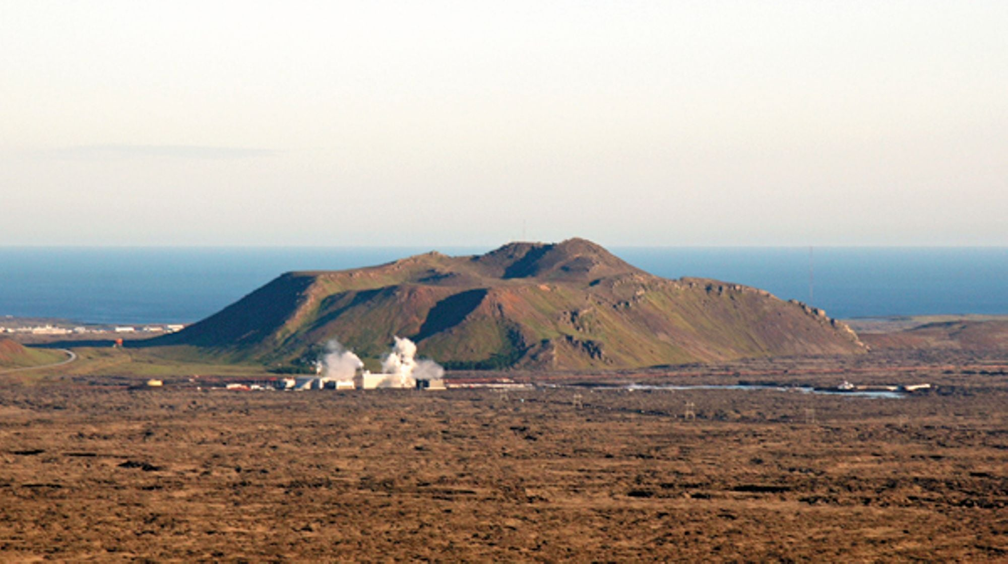
ICELAND:
MOUNT THORBJÖRN VOLCANO
Image source: holidayautos.com

Slide 2
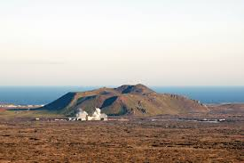
STUDY THE ICELAND GEOLOGY MAP ON THE NEXT SLIDE AND FIND MOUNT THORBJÖRN.
What type of geology is this area?
How would you expect this sort of magma / lava to behave?
What sort of volcanic activity do you associate with this geology and lava type?
What is different about the location of Thorbjörn compared to the location of other volcanoes such as Eyjafjallajökull and Grimsvötn? How might this affect potential volcanic activity and the volcanic products of any future eruption?
Image source: Visitreykjanes.is

Slide 3
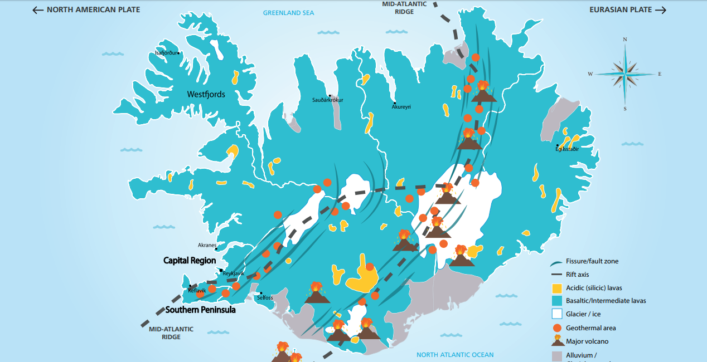
Grimsvötn
Mount Thorbjorn
Grindavik
Eyjafjallajökull
https://www.discover-the-world.com/study-trips/comparing-lava-types/
Notes:
See https://www.discover-the-world.com/study-trips/comparing-lava-types/ for full download of the Lava Types resource including PDF geology map

Slide 4
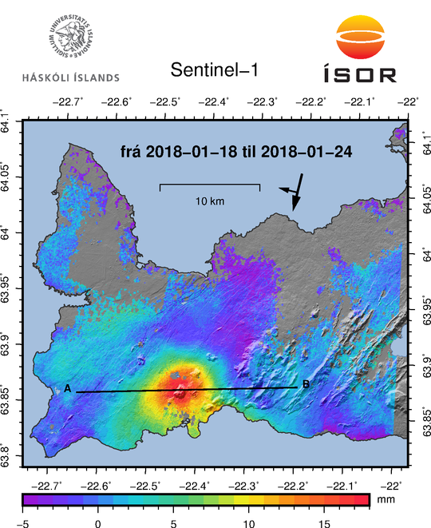
ANALYSE THE IMAGE WHICH SHOWS INSAR SATELLITE INFORMATION OF GROUND INFLATION.
Estimate the amount of inflation in the central area of Mount Thorbjörn.
Look at the scale. The transect A-B is approximately 23km. Estimate the diameter of the main inflation zone (above 8mm).
Describe the overall pattern of ground deformation.
Mount Thorbjorn
Grindavik
(InSAR: Interferometric analysis of Synthetic Aperture Radar images)

Slide 5
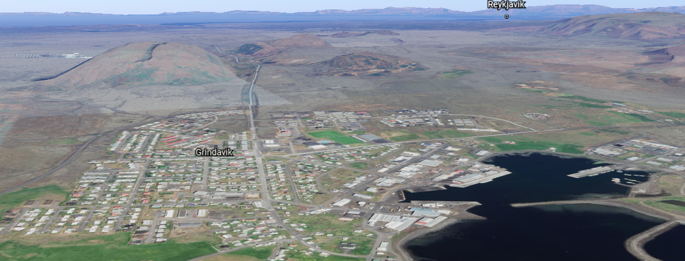
FROM THE GOOGLE IMAGE:
Suggest three potential sources of economic losses from a future eruption.
Suggest three possible social impacts to this area of a future eruption.
Svartsengi Geothermal power
Mount Thorbjorn

Slide 6
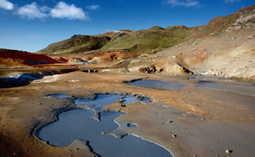
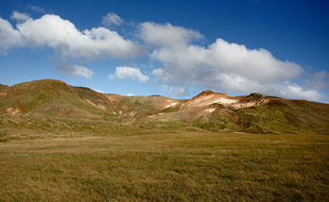
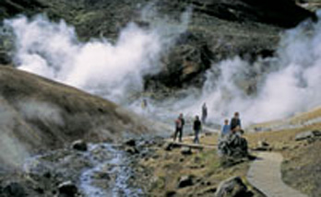
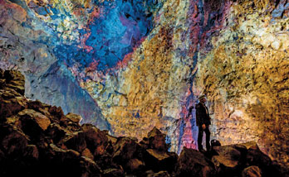
THE REYKJANES PENINSULA HAS NOT HAD
A VOLCANIC ERUPTION SINCE THE 13TH CENTURY.
How might this knowledge affect how local people behave, how they interpret the news about current possible activity?
How would you feel if you were living in Grindavik fishing community?
Suggest reasons why people might choose to live in potential risk zones such as Iceland.

Slide 7
THE PEOPLE OF GRINDAVIK WERE INVITED
TO A CIVIL MEETING ON 26TH JANUARY
TO DISCUSS THE ACTIVITY AND POSSIBLE
FUTURE EVACUATION PLANS.
Imagine you were living in Grindavik and your mobile phone received warning that a volcanic eruption was starting. State your top 5 priorities for how you would respond to the evacuation order.
Many people are currently preparing evacuation bags just in case, that they can keep nearby for the foreseeable future. What ten items would you recommend go into their evacuation grab bag and why?

Slide 8
DECISION MAKING EXERCISE
You are a member of the Icelandic Department for Civil Protection. You have the responsibility of taking the information, and making a decision about how best to manage any future threats.
What data could be collected as evidence of possible increased volcanic activity? (Think about the signs of an eruption that could be measured)
What are the dangers of making an evacuation order too soon, before an eruption has begun?
List which groups of people you need to consider the views of.
Imagine that the situation worsens: earthquakes become more frequent and shallow and stronger, tiltmeters show ground inflation increases, etc. Suggest how you would manage the situation, what would you tell local people to do? How would you care for tourists arriving into Keflavik airport? What would you instruct services and emergency teams to do?

